Slide 1
Anti-Discrimination Working Group
Meeting #3
Wednesday, 23 June 2023
10.00, NCRR main meeting room (and online)

Slide 2

Agenda
Introduction round
Aims of the group
Embryonic/prenatal genetic testing in Denmark
Polygenic embryo screening
Discussion
Ideas for next meeting

Slide 3

Introductions

Slide 4
Aims of the group
To strive for equality
To strive for diversity
To be open & transparent
To be mindful that the topics we discuss may be triggering and upsetting, impacting on people in different ways.
This is not a passive intellectual topic. It takes time to install the correct support and find solutions. This is a learning process.
To discuss ongoing issues with discrimination in research
To recognize harmful structures and practices of discrimination in research
To advocate for changes that promote equity in research

Slide 5
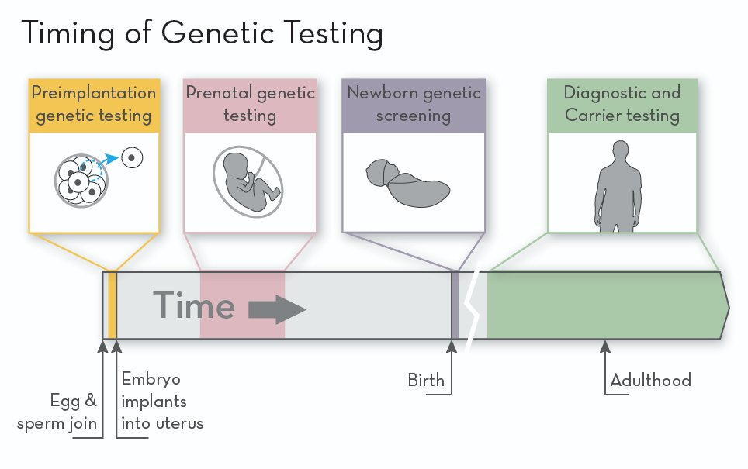
Genetic testing
IVG Timeline [Online image]. Learn Genetics. https://learn.genetics.utah.edu/content/disorders/whatispgt
Notes:
There are several types of genetic testing that are used to screen for genetic disorders at different stages of the reproductive process
In this presentation, we will focus mostly on these first two
First, we will talk about preimplantation genetic testing or PGT, which involves testing embryos before they are implanted into the uterus
Next, we will move on prenatal genetic testing, which is used during pregnancy
Then, we will go back to pre-pregnancy and talk about polygenic embryo screening

Slide 6
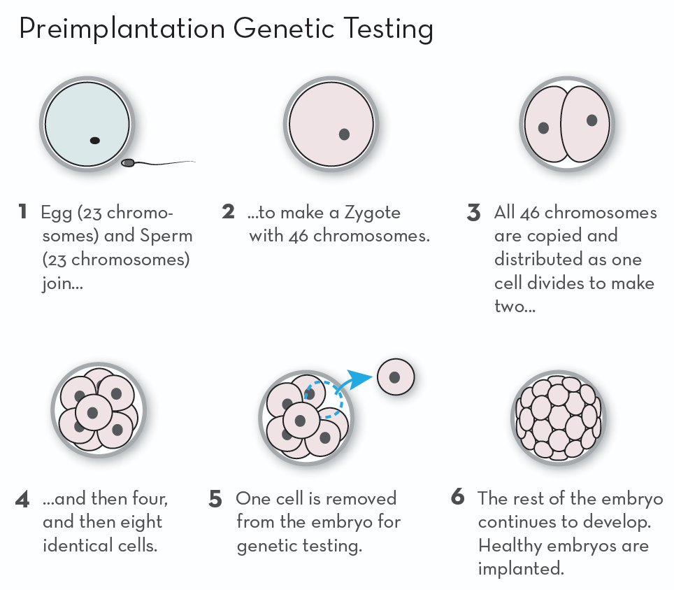
Pre-implantation genetic testing (PGT)
PGT for Aneuploidy (PGT-A)
Chromosomal abnormalities (e.g., Down syndrome, Turner syndrome)
Deselection of affected embryos to optimize pregnancy rates and reduce miscarriage rates
PGT for Monogenic/Single Gene Disorders (PGT-M) and PGT for Chromosomal Structural Rearrangements (PGT-SR)
Known genetic disorders (e.g., Huntington's disease, cystic fibrosis, Tay-Sachs)
Reduce risk of transmitting genetic disorders
PGT [Online image]. Learn Genetics. https://learn.genetics.utah.edu/content/disorders/whatispgt
Notes:
Let's start with pre-implantation genetic testing or PGT, which is sometimes called "egg sorting"
PGT is used in the context of IVF, which involves fertilizing eggs outside of the body and transferring one or more embryos to the uterus
This image shows that PGT can be done once a fertilized egg has divided enough times to make at least eight cells (step 4), then testing can be carried out on a single cell (step 5)
At this point, I wanted to mention which disorders PGT screens for, though that depends on the subtype of PGT
PGT-A can detect chromosomal abnormalities such as Down syndrome and Turner syndrome
Essentially, PGT-A checks whether the embryo has the 23 pairs of chromosomes
PGT-A is used for the deselection of affected embryos to increase the chances of a successful pregnancy and reduce the risk of miscarriage
Then, there is PGT-M and PGT-SR, which are used to identify embryos with known genetic disorders such as Huntington's disease and cystic fibrosis
The aim is to reduce the risk of transmitting genetic disorders

Slide 7
Pre-implantation genetic testing (PGT)
Cells are biopsied from the embryo at the blastocyst stage (~5⎯7 days after fertilization)
Genetic material is analyzed
Unaffected embryos are selected for transfer
Tests are highly sensitive and very accurate (95⎯99%)
"Discarding embryos five days after fertilization in PGT appears – in all aspects – to be ethically acceptable and in harmony with a traditional Nordic principle of ethical gradualism." (Ingerslev et al., 2020)
Notes:
A little bit about how this works...
Cells are taken from the embryo about 5-7 days after fertilization
The genetic material is then analyzed, and the response time is approximately 4 weeks
Unaffected embryos are then selected for transfer to the uterus
Current evidence suggests that PGT is highly sensitive and very accurate, so the risk of misdiagnosis is low, though a confirmatory prenatal test is often recommended
I wanted to share this excerpt from an editorial written by some clinicians/researchers at the Aalborg University Hospital, as it may relate to the discussions we will have in a moment

Slide 8

PGT in Denmark
Publicly funded
Rigshospitalet Copenhagen and Aalborg University Hospital
~10x more PGT per million inhabitants than Norway, 3x more than Finland, and 2x more than Sweden/Iceland (Hreinsson et al., 2020)
PGT-M/PGT-SR: Parent(s) with a high risk of transmitting a severe genetic disorder
PGT-A: Allowed within an approved research protocol
Notes:
Since at least 2017, PGT has been publicly funded in Denmark
PGT is considered a highly specialized function and is performed at two national centers: Rigshospitalet in Copenhagen and Aalborg University Hospital
With respect to utilization of PGT in Denmark:
In 2020, the PGT Study Group conducted a survey of PGT practices in the Nordic countries, which revealed that Denmark was "the top scorer", with almost 10x more treatments per million inhabitants than Norway, 2-3x more treatments per million inhabitants than Sweden, Iceland, and Finland
With respect to access to the different subtypes of PGT in Denmark:
PGT-M and PGT-SR are allowed unconditionally, whereas PGT-A is only allowed within an approved research protocol
PGT-M and PGT-SR are typically offered to parent(s) who have a high risk of transmitting a severe genetic disorder
**Sex selection is allowed in the case of X-linked disease, but not for family balancing

Slide 9
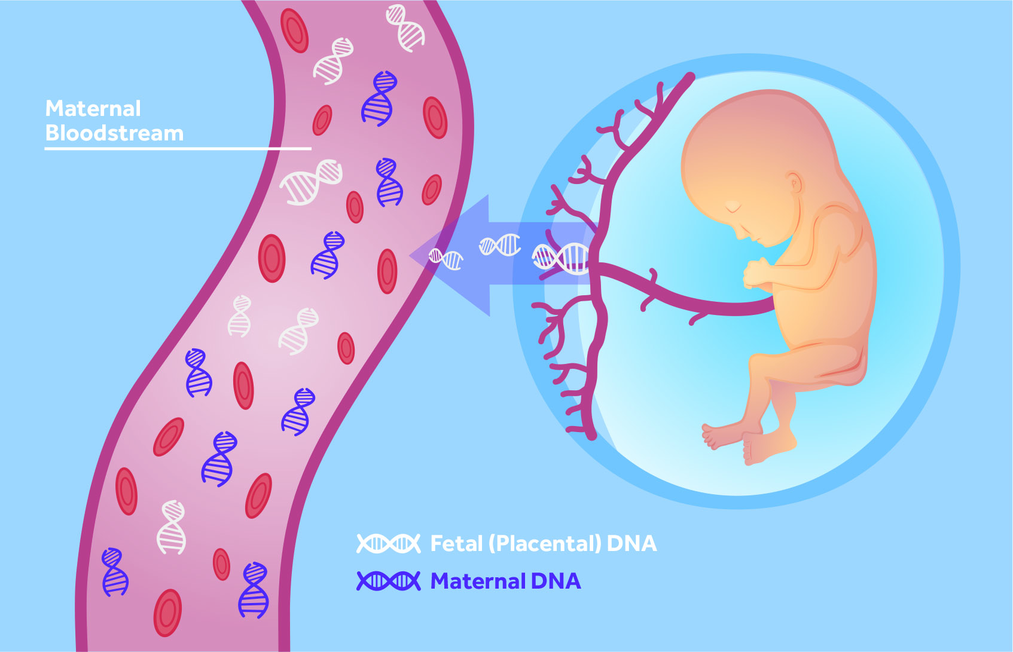
Non-invasive prenatal screening (NIPT)
Chromosomal abnormalities:
Down syndrome (trisomy 21)
Patau syndrome (trisomy 13)
Edwards syndrome (trisomy 18)
After the first-trimester scan (week 11⎯13)
Measures the amount of fetal DNA corresponding to chromosomes 13, 18, and 21
Estimate whether risk is increased or decreased
High sensitivity and specificity (90⎯99%)
Fetal placental DNA image [Online image]. St George’s University Hospitals. https://www.stgeorges.nhs.uk/service/maternity-services/your-pregnancy/fetal-medicine-unit/the-safe-test/
Notes:
Moving on to non-invasive prenatal screening or NIPT:
NIPT is used to screen for chromosomal abnormalities including Down syndrome, Patau syndrome, and Edwards syndrome
It is typically carried out in weeks 11 to 13 of pregnancy and involves taking a blood sample from the pregnant person
The sample is then used to analyze both fetal and maternal cell-free DNA
This image shows that the mother's bloodstream contains a mixture of cell-free DNA from her cells as well as cells from the placenta that are shed during pregnancy
NIPT is considered non-invasive since it does not pose any risk to the fetus, and I will talk shortly about invasive procedures and the risks they carry
Though NIPT cannot definitively diagnose genetic conditions, the results will provide an estimate of whether the risk of having certain conditions is increased or decreased
Current evidence suggests that the sensitivity and specificity of NIPT ranges from 90-99% with false-positive rates of <1%

Slide 10
NIPT in Denmark
1973-2004: Invasive prenatal screening (Down syndrome) in high-risk pregnancies only
2004: National combined first-trimester screening (cFTS) program
High uptake (>96%) of cFTS (Lund et al., 2021)
2013: NIPT introduced as an alternative in high-risk pregnancies
2017: National NIPT program
Notes:
Before 2004, prenatal screening for Down syndrome was offered in high-risk pregnancies only and typically involved invasive procedures such as samples taken from placental tissue, amniotic fluid, or fetal blood from the umbilical cord
These invasive procedures have some risks, though they are small (~0.5-1.0%), including infection and miscarriage
Then in 2004, Denmark became the first country in the world to introduce a national combined first-trimester screening (or cFTS) program
So, prenatal screening for Down syndrome was no longer reserved only for high-risk pregnancies, though cFTS still involves invasive procedures
Overall, Denmark has a high uptake of prenatal screening
In 2013, Denmark saw the first clinical implementation of NIPT, which was offered in high-risk pregnancies only
Then in 2017, Denmark became one of the first countries to offer NIPT in all pregnancies
Interestingly, unpublished results show that only 20% of women in the high-risk group choose NIPT as an alternative to invasive procedures, which is thought to be due to invasive procedures potentially providing more information
**Saw on the Rigshospitalet website that the parent(s) can consult with a genetic counsellor about the results

Slide 11
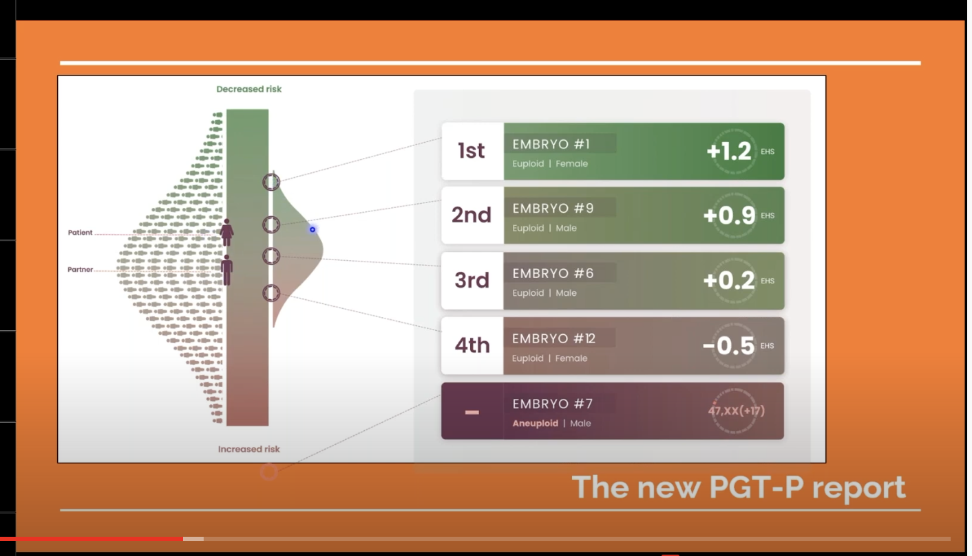
Polygenic embryo screening (PES)
The application of polygenic risk scores in the context of PGT, in order to determine each embryo’s liability for one or more diseases/traits, and to guide selection of an embryo for implantation (Lencz et al., 2022)
Screenshot from Genomic Prediction presentation [Online image]. (2021). Center for Genetics and Society. https://www.geneticsandsociety.org/biopolitical-times/first-polygenic-risk-score-baby
Notes:
Great discussion piece: https://journals.library.columbia.edu/index.php/bioethics/article/view/9467
First child born after use of PES with company GenomicPrediction, AKA “LifeView”: https://www.lifeview.com/
News article: https://www.geneticsandsociety.org/biopolitical-times/first-polygenic-risk-score-baby

Slide 12
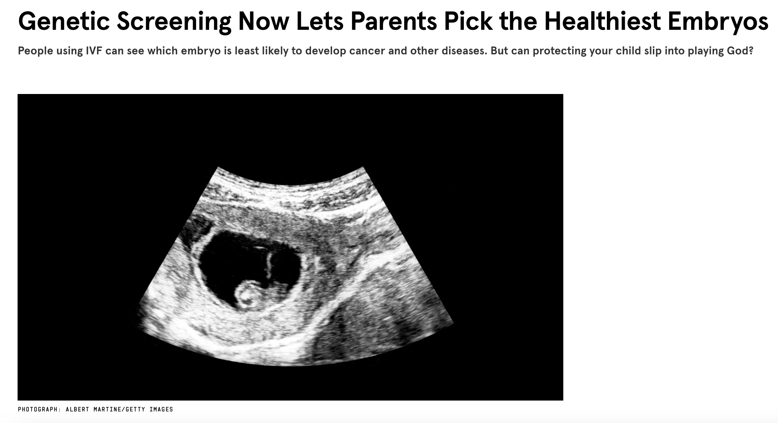
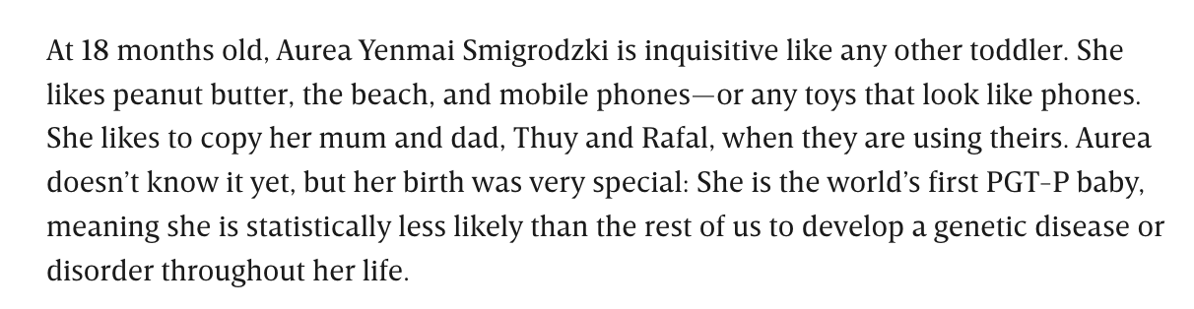
Embryonic screening and eugenics
https://www.wired.co.uk/article/genetic-screening-ivf-healthiest-embryos

Slide 13
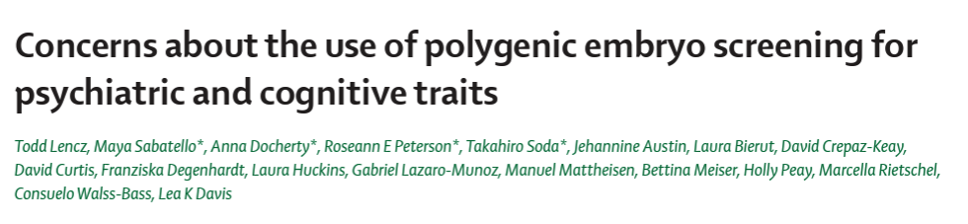
Polygenic embryo screening (PES)

Slide 14
Polygenic embryo screening (PES)
For thirty years, preimplantation genetic testing has been a routine part of IVF.
Identification of embryos with monogenic disease-causing alleles (e.g., CF, Tay-Sachs disease).
PES is a new technique.
Commercially available from at least one provider.

Slide 15

Polygenic embryo screening (PES)
For thirty years, preimplantation genetic testing has been a routine part of IVF.
Identification of embryos with monogenic disease-causing alleles (e.g., CF, Tay-Sachs disease).
PES is a new technique.
Commercially available from at least one provider.

Slide 16

Why should we be concerned about PES?
I don’t see the problem with PES. Surely we want to try and improve the health of the population? If PES is trying to achieve this, what is the problem? How is this any different to PGT and NIPT?

Slide 17

Why should we be concerned about PES?
I don’t see the problem with PES. Surely we want to try and improve the health of the population? If PES is trying to achieve this, what is the problem? How is this any different to PGT and NIPT?
There are many issues with PES.

Slide 18
Why should we be concerned about PES?
I don’t see the problem with PES. Surely we want to try and improve the health of the population? If PES is trying to achieve this, what is the problem? How is this any different to PGT and NIPT?
There are many issues with PES.

Slide 19
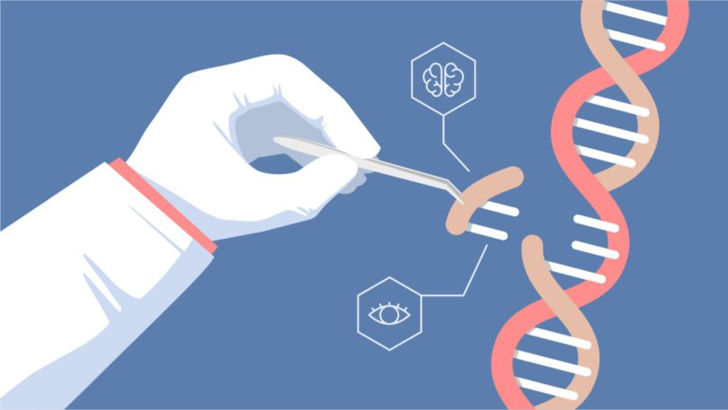

Why should we be concerned about PES?
PES
There are many issues with PES.
Practical/scientific
issues about efficacy
Ethical issues

Slide 20
Practical/scientific issues with PES
Issues with accuracy
1. PES depends on accuracy of polygenic scores (sample size and trait heritability).
2. Variance explained by a polygenic score is much lower than SNP-based h2 (which, in turn, is much lower than broad-sense H2).
3. Polygenic scores are based on GWAS results which may also capture genetic nurture.
4. Polygenic scores are inherently probabilstic and capture risk for multiple phenotypes.
Health disparities*
Regulatory issues
5. Polygenic scores are not transferrable across genetic ancestries.
6. The goals of PES are not clearly defined. What do parents want?
7. No established guidelines on communication of results of polygenic scores, what they mean, and what parents can expect from PES.
8. Regulations differ across countries. This could lead to reproductive tourism.
*Practical and ethical

Slide 21
Ethical issues with PES
Costs to society
1. Encouragement of eugenicist beliefs.
2. Encouragement of genetic essentialism.
3. Encouragement of fatalism.
4. Increased stigma around certain disorders/traits.
Costs to research
5. Need to take into account views of research participants (e.g., in GWASs).
6. Researchers feeling that their contributions have been misused.
7. Distrust of genetics research community.

Slide 22
Statement issued by the International Society of Psychiatric Genetics (ISPG)
ADVISORY ON THE USE OF POLYGENIC RISK SCORES TO SCREEN EMBROS FOR ADULT MENTAL HEALTH CONDITIONS.
Approved by the ISPG Board May, 2021
Several private companies are using polygenic risk scores to screen embryos for adult mental health conditions. The screening is done as part of in-vitro fertilization. A polygenic risk score is a single number that measures part of a person’s genetic predisposition for a condition¹. These genetic scores are built by adding up the small effects from many hundreds or thousands of genes. Although in general higher scores mean you are more likely to have a condition, many healthy people will have high scores; others might develop the condition even with a low score. The accuracy with which a polygenic score can predict psychiatric illnesses, such as schizophrenia, bipolar disorder and major depression, is currently not sufficient for clinical use. Furthermore, the unintended consequences of its use for embryo selection need to be considered. While polygenic risk scores are used in research, there are currently no clinical uses in psychiatry.
The ISPG views with concern the offering of polygenic embryo screening services for psychiatric conditions, for both scientific and ethical reasons. First, polygenic risk scores do not determine whether a person will develop a condition. They measure just one of many possible risk factors. Second, polygenic risk scores are not specific to a single condition. This means that selection for one condition can affect other genetic traits. Third, it is not known how to accurately communicate the level of risk to prospective parents. Fourth, in many countries, there is no regulation or oversight of polygenic embryo screening to protect against misuse, like there is for other kinds of genetic testing. Fifth, screening embryos for psychiatric conditions may increase stigma surrounding these diagnoses. Finally, psychiatric genetics has a history of misuse for eugenics²⁻⁴, and polygenic embryo screening raises many ethical, legal, and social issues that can potentially lead to harm and have not yet been studied or addressed⁵.
While scientific and ethical issues have been widely studied for single-gene embryo testing⁶, the issues listed above have not been explored for polygenic embryo screening. The few published polygenic embryo screening studies have been mostly led by a private company selling these services^{7–11}. Public discussion and debate including all potential stakeholders is urgently needed on a national and international scale. Given these considerations, the ISPG urges caution and calls for additional research and oversight on the use of polygenic embryo screening.
Notes:
First professional biomedical organization to release a statement on PES
The accuracy with which a PRS can predict psychiatric disorders is currently not sufficient for clinical use
Need to consider the unintended consequences of using PRS for embryo selection
PRS cannot determine whether a person will develop a condition
PRS are not specific to a single condition
Screening embryos for psychiatric conditions may increase stigma surrounding these diagnoses

Slide 23
Discussion
Does PES perpetuate societal biases and reinforce notions of genetic superiority/inferiority? Discrimination/stigmatization of individuals with certain traits?
Potential loss of genetic diversity and impact on the wider population due to the selective avoidance of certain disorders/traits?
Impact on genetics research: Will this discourage participation from diverse, under-represented communities and increase the health disparities that already exist?
Research contributions being misused or applied in a way that we find problematic?
Notes:
Before we jump into these questions, I thought we could have a broader discussion
What do we think about PRS potentially being used in PES?
Someone mentioned in the last meeting that they have been approached at a conference by someone who had recently launched a company that does PES and wanted to potentially collaborate on some work
Does anyone else have any experience with this?
Does this perpetuate societal biases? While PES is purported to be used for the deselection of affected embryos, does this translate to using PES for the selection of superior embryos?
A question I had personally as someone that is new to genetics: Would this lead to a loss of genetic diversity? And would this have an impact on the wider population due to the selective avoidance of certain genetic disorders?
What about the impact on genetics research:
The article we recommended talks about the people who contribute to these GWASs potentially not consenting to data being used in this way. Will this lead to further distrust in genetics research and people from diverse under-represented communities being even less likely than they already are to participate?
What about negative consequences on researchers, if our research is being misused and applied in a way that we find problematic?

Slide 24

Ideas for next meeting
Genetic counselling?
Bioethics?
Discrimination at the workplace (academia/research)?

Slide 25





Thanks – Have a great summer!
Next meeting:
August?
Jess Mundy
Hannah Chatwin
Alisha Hall
Jette Steinbach
jmundy@clin.au.dk
hchatwin.ncrr@au.dk
alishasmhall@clin.au.dk
jst.ncrr@au.dk
@jessmndy
@hannahchatwin2
@asmhall
_

Slide 26
References & further resources
Hreinsson, J, Iwarsson, E, Hanson, C, et al. (2020). Preimplantation genetic testing legislation and accessibility in the Nordic countries. Acta Obstetricia et Gynecologica Scandinavica, 99, 716-721.
Ingerslev, H.J., Kesmodel, U.S., Jacobsson, B. and Vogel, I. (2020), Personalized medicine for the embryo and the fetus – Options in modern genetics influence preconception and prenatal choices. Acta Obstet Gynecol Scand, 99, 689-691.
Lencz et al., (2022), Concerns about use of polygenic embryo screening for psychiatric and cognitive traits. Lancet Psychiatry.
Lund, ICB, Petersen, OB, Becher, NH, et al. (2021). National data on the early clinical use of non-invasive prenatal testing in public and private healthcare in Denmark 2013–2017. Acta Obstet Gynecol Scand, 100, 884-892.
Toft, C. L., Diemer, T., Ingerslev, H. J., Pedersen, I. S., Adrian, S. W., & Kesmodel, U. S. (2022). Patients' choices and opinions on chorionic villous sampling and non‐invasive alternatives for prenatal testing following preimplantation genetic testing for hereditary disorders: A cross‐sectional questionnaire study. Prenatal Diagnosis, 42(2), 212-225.

